Slide 1


Chicago Crime rate
How Socioeconomic factors influence the crime rate

Slide 2


Analysts
Christopher Habib
Siddharth Krishnan
Ali Kashani
Elmaddin Karimov

Slide 3

Data Curated datasets:
https://dev.socrata.com/foundry/data.cityofchicago.org/6zsd-86xi
https://data.cityofchicago.org/Health-Human-Services/Census-Data-Selected-socioeconomic-indicators-in-C/kn9c-c2s2

Slide 4
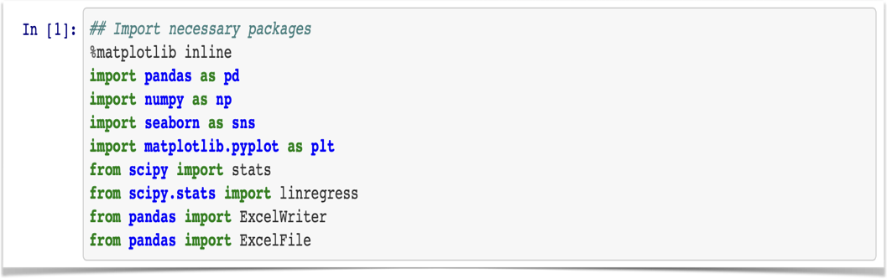
Import Packages
The above Packages for executing our analysis

Slide 5
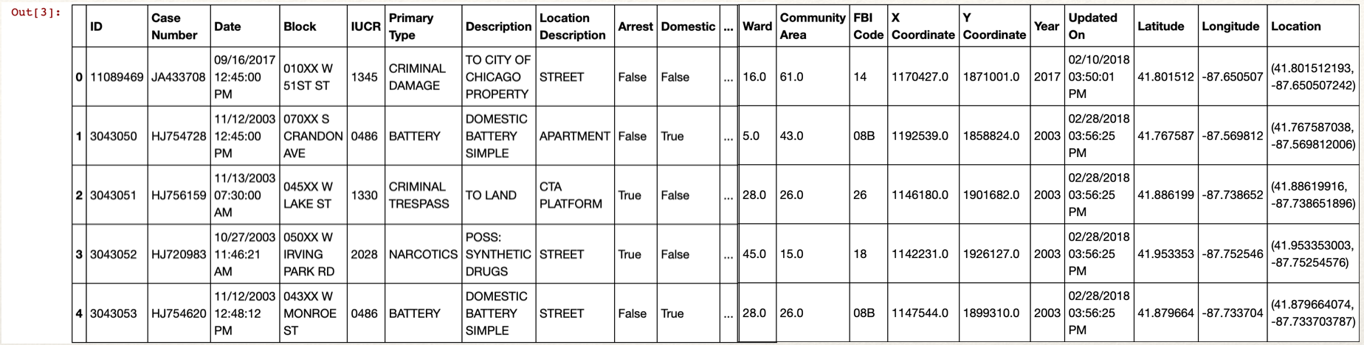
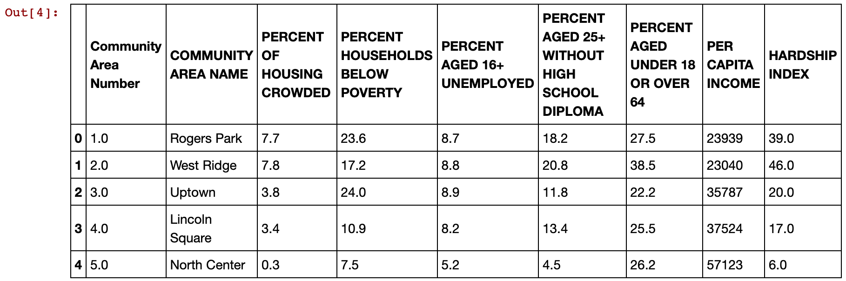
df = pd.read_csv(‘resources/Crimes_-_2001_to_present.csv')
census = pd.read_csv('resources/Census_Data_-_Selected_socioeconomic_indicators_in_Chicago__2008___2012.csv')

Slide 6
Data Cleaning
Extract Crime data for years 2008-2012
Changed combined thefts, robberies and auto-thefts into a single THEFT category
Merged both datasets on Community Area column
Checked for null-values

Slide 7

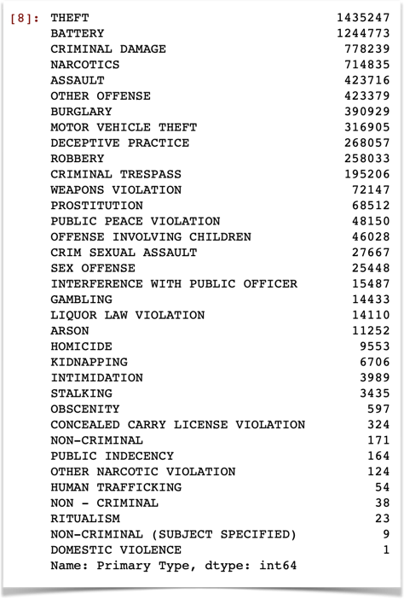
By using this syntax
We determined the most committed Crime
df['Primary Type'].value_counts()

Slide 8
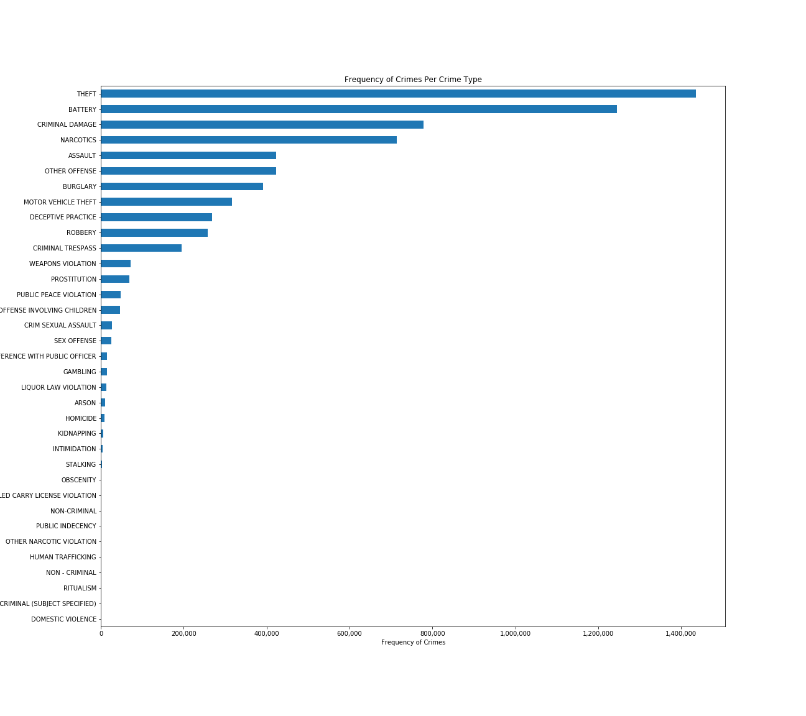

Slide 9
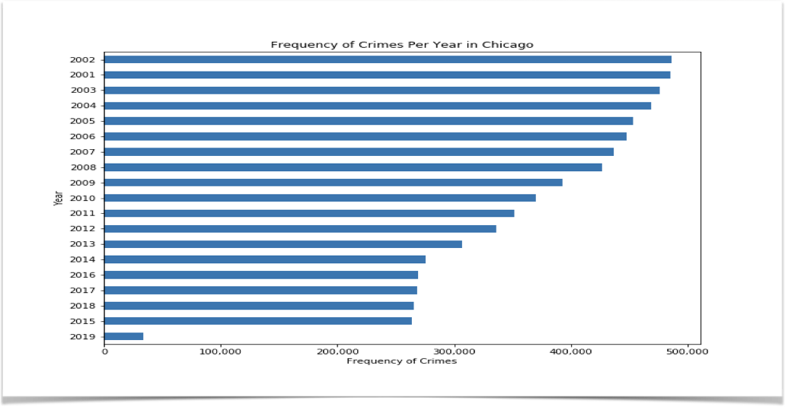
Determined Frequency of Crimes per year

Slide 10
Merging the Data to analyse and determine a relationship
Between Hardship Index and Theft
crime08 = df.loc[df["Year"]==2008]
crime09 = df.loc[df[“Year"]==2009]
crime10 = df.loc[df["Year"]==2010]
crime11 = df.loc[df["Year"]==2011]
crime11 = df.loc[df["Year"]==2011]
crime12 = df.loc[df["Year"]==2012]
crime_data=pd.merge(crime08,census,on="Community Area")
crime_data1=pd.merge(crime09,census,on="Community Area")
crime_data2=pd.merge(crime10,census,on="Community Area")
crime_data3=pd.merge(crime11,census,on="Community Area")
crime_data4=pd.merge(crime12,census,on="Community Area")
crime2=pd.concat([crime_data, crime_data1,crime_data2,crime_data3,crime_data4])
crime2.columns
theft=crime2.loc[crime2["Primary Type"]=="THEFT"]
theft

Slide 11
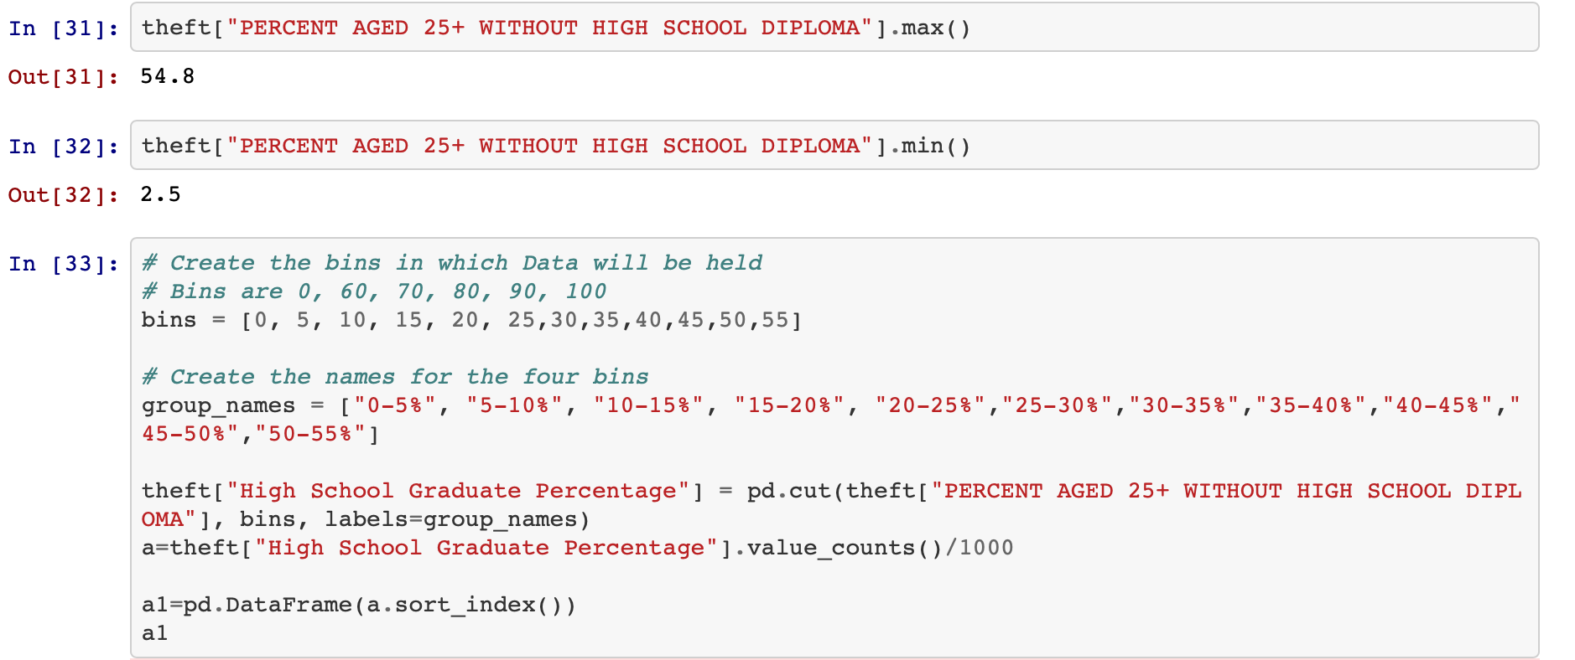
Relationship between Theft and High School Diploma

Slide 12
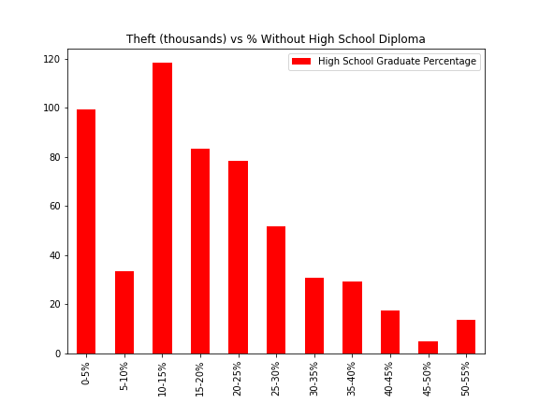
Theft vs % Without High School Graduate Percentage
 | High School Graduate Percentage
0-5% | 99.358
5-10% | 33.626
10-15% | 118.199
15-20% | 83.236
20-25% | 78.196
25-30% | 51.724
30-35% | 30.704
35-40% | 29.352
40-45% | 17.390
45-50% | 5.033
50-55% | 13.641

Slide 13
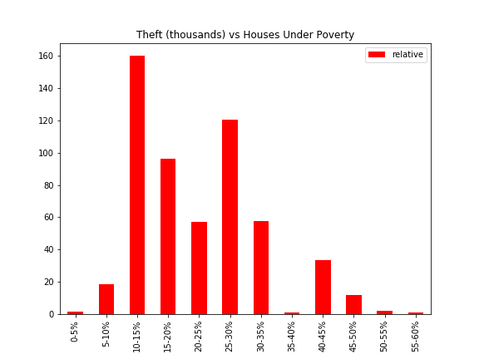
Theft vs % Houses Under Poverty

Slide 14
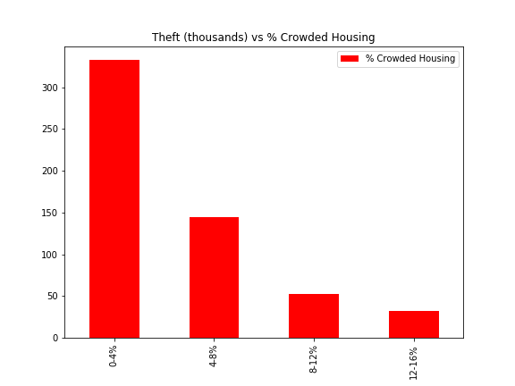
Theft vs % Crowded Housing

Slide 15
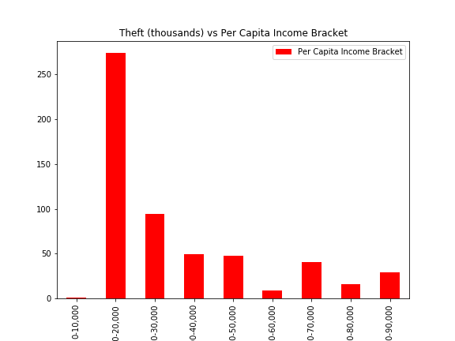
Theft vs Per Capita Income Bracket

Slide 16
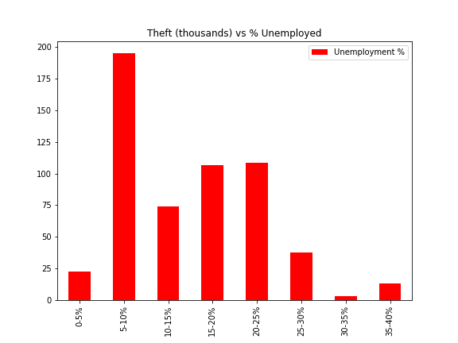
Theft vs % Unemployed

Slide 17
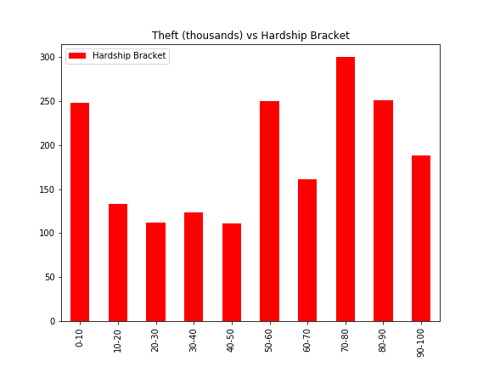
Theft vs Hardship Bracket

Slide 18
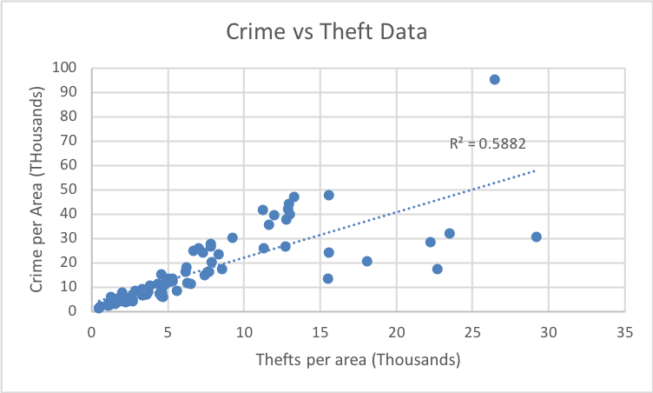
Crime vs Theft Data

Slide 19
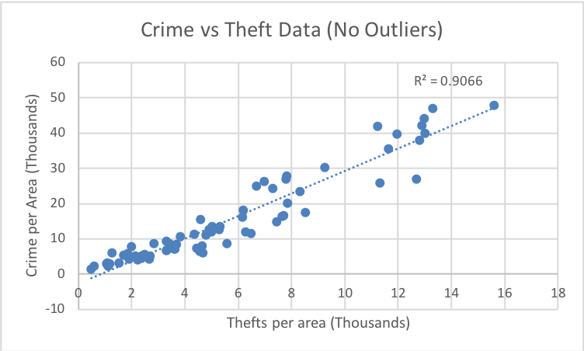
Crime vs Theft Data (No Outliers)

Slide 20
Our goal
Find crime types and obtain data from the right source
Analyse and clean data
Find which crime was the most highest committed
Percentage of arrested and not arrested?
By using the socioeconomic indicators we analysed 4 years of data
Select crime data for 5 years 2008-2012
Merge the new data to get meaningful insights
Analyse impact of indicators on theft levels
Analyse correlation between theft and crime levels

